Slide 1
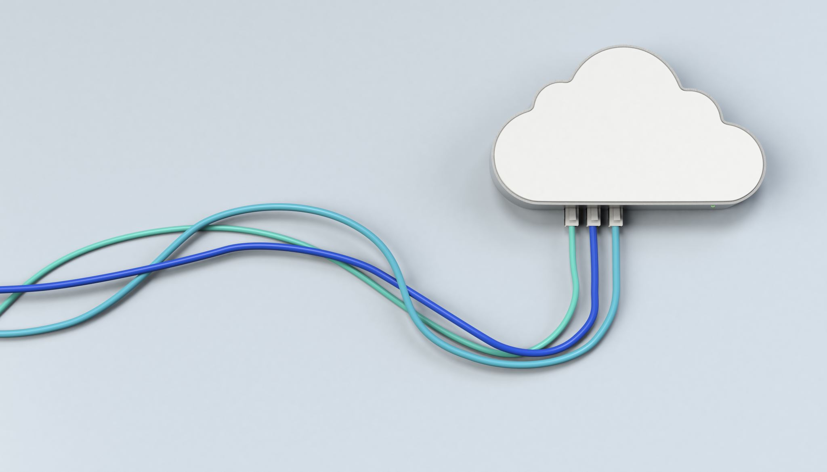
CHAPTER 6 Security Reference Model
|Cloud Computing

Slide 2
Introduction to Cloud Security
Cloud Computing Overview: A model for delivering IT services over the internet, offering scalability and cost-efficiency.
Security Challenges: Cloud computing shifts control from on-premises to remote infrastructure, necessitating new security approaches.
Need for Cloud Security: Traditional perimeter-based security is inadequate; new strategies are required to protect data and applications effectively.

Slide 3
The Importance of Cloud Security
Security Necessity: Protecting data integrity, customer information, and compliance with regulations in the cloud.
Risk of Data Breaches: Increased exposure to threats due to the remote nature of cloud services.
Compliance Requirements: Avoiding legal and financial repercussions by ensuring robust cloud security measures.

Slide 4
Traditional Security Boundaries
Traditional Model Focus: Protects internal network perimeter using firewalls and intrusion detection systems.
Limitations: Less effective in cloud environments where resources are accessed remotely and boundaries are blurred.
Security Measures: Emphasis on defending against external threats and safeguarding internal resources.

Slide 5
De-perimeterization in Cloud Computing
Concept: Traditional network boundaries are no longer effective in cloud environments.
Security Approach: Requires new strategies for protecting data and applications without relying on physical network perimeters.
Need for Comprehensive Security: Emphasizes the importance of security models that address distributed and open environments.

Slide 6
Security Concerns in Cloud
Privileged User Access: Managing and monitoring elevated permissions.
Regulatory Compliance: Adhering to data protection laws and standards.
Data Location: Ensuring compliance with regional data sovereignty laws.
Data Segregation: Protecting data in shared environments.
Recovery: Effective backup and recovery processes.
Investigative Support: Mechanisms for investigating security incidents.
Long-Term Viability: Addressing risks related to service provider stability.

Slide 7

Introduction to Cloud Cube Model
Overview: Framework for evaluating cloud security challenges with a three-dimensional perspective.
Dimensions: Includes data boundaries, ownership models, security boundaries, and sourcing.
Purpose: Provides a structured approach to understanding security risks in various cloud configurations.

Slide 8
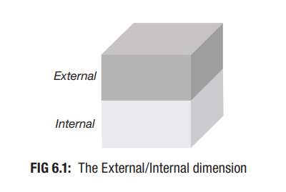
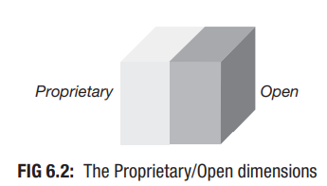
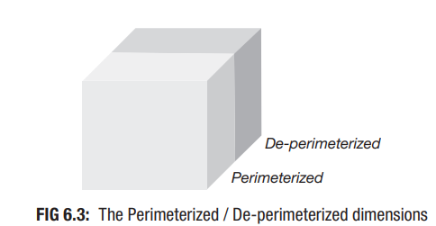
Dimensions of Cloud Cube Model
Data Boundary: Internal (I) vs. External (E) data boundaries.
Ownership: Proprietary (P) vs. Open (O) ownership models.
Security Boundary: Perimeterized (Per) vs. De-perimeterized (D-p) security approaches.
Sourcing: Insourced vs. Outsourced sourcing models.
Configurations: 16 possible configurations based on different dimension combinations.

Slide 9
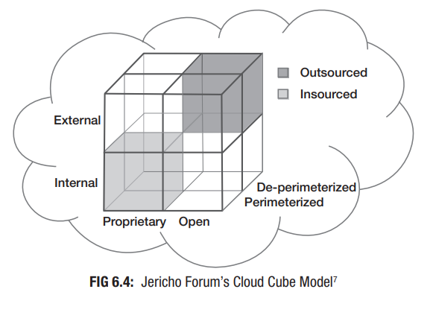
Visual Representation of Cloud Cube Model
Cube Visualization: Graphical representation of the Cloud Cube Model with axes for each dimension.
Configurations: Illustration of 16 unique configurations and their security characteristics.
Application: Examples of configurations to demonstrate how the model can be used to assess and enhance cloud security strategies.

Slide 10
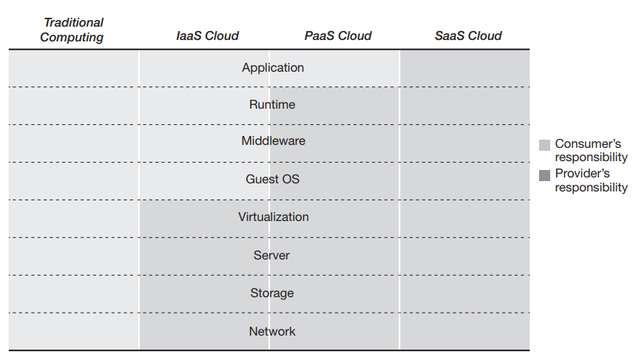
Examining Cloud Security vs. Traditional Computing

Slide 11
Security Management Responsibilities
IaaS (Infrastructure as a Service):
Provider: Manages the physical infrastructure (servers, storage, network).
Consumer: Responsible for managing the operating system, applications, and data.
PaaS (Platform as a Service):
Provider: Manages infrastructure and platform services (runtime environments, middleware).
Consumer: Manages applications and data security.
SaaS (Software as a Service):
Provider: Handles the entire stack, including infrastructure, platform, and applications.
Consumer: Focuses on managing user data and access.
Traditional Computing:
Consumers: Handle all aspects of security from physical hardware to application-level security.
In-house Management: Requires comprehensive security measures across all layers, including hardware, network, and software.

Slide 12
Trusted Cloud Computing
Trusted Computing:
Technologies and policies designed to create secure and reliable computing systems.
Trust in cloud computing is essential for widespread adoption.
Trust Challenges:
Consumer scepticism regarding cloud security.
Efforts by providers to address concerns about insider and outsider threats.
Certification Programs:
Certifications like CSA STAR provide assurance of security and compliance.
Act as quality stamps for cloud services, boosting consumer confidence.
Provider Transparency:
Major providers (e.g., Google, Amazon, Microsoft) work to increase transparency regarding their security practices.
Ongoing efforts to build and maintain trust with consumers.

